Slide 1


OBJECT DETECTION
DEPARTMENT OF COMPUTER SCIENCE & ENGINEERING
UNIVERSITY INSTITUTE OF TECHNOLOGY
RAJIV GANDHI PROUDYOGIKI VISHWAVIDHYALAYA BHOPAL

Slide 2
OUR TEAM MEMBER
ANIKET KUMAR SINGH (0101CS171011)
MOKSH TEKAM (0101CS171062)
HARSH PARTE (0101CS171045)
DEVANG DAMADE (0101CS171032)
HITESH KATARA(0101CS171048)
OUR MENTOR
Dr. RAJEEV PANDEY
PROF. MANISH MISHRA

Slide 3
ABSTRACT
Real time object detection is a vast, vibrant and complex area of computer vision.
This detects the semantic objects of a class in digital images and videos. The applications of real time object detection include tracking objects, video surveillance, pedestrian detection, people counting, self-driving cars, face detection, ball tracking in sports and many more.
Convolution Neural Networks is a representative tool of Deep learning to detect objects using Open CV (Open source Computer Vision), which is a library of programming functions mainly aimed at real-time computer vision.

Slide 4
List Of Table
Introduction
Motivation And Purpose
Related Technology
Developing a Object Detector
Future scope
Conclusion
References

Slide 5
INTRODUCTON
The modern world is enclosed with gigantic masses of digital visual information
To analyze and understand this huge sea of visual information, there exist many image analysis techniques
Those methods that automatically recognize and detect the objects prove to be of great use and provide a significant help in modern applications and devices
The semantic and syntactic contents of the images can be recognized and further processed to get the necessary information.
The important content of image is the objects in the image. There exists a significant and essential need for object recognition techniques
Recognition is an important task in image processing and computer vision. A set of known tags can be used to identify what really the object is and help to extract information.

Slide 6
Motivation And Purpose
The basic motivation behind this topic is that it is something that will over do all the physical tasks.
Robotics and smart systems are buzzing around all over the world
Object recognition and tracking reduces human efforts and provides efficiency.
It is of interest as it may help humans to be aware of minute information about particular objects and reduce human tasks.
Automatic recognition and extraction adds to the smart systems used today.

Slide 7
RELATED TECHNOLOGY
R-CNN - R-CNN is a progressive visual object detection system that combines bottom-up region proposals with rich options computed by a convolution neural network.
SINGLE SHOT DETECTOR - Single Shot detector like YOLO takes only one shot to detect multiple objects present in an image using multibox.
YOLO - YOLO is real-time object detection. It applies one neural network to the complete image dividing the image into regions and predicts bounding boxes and possibilities for every region.
TENSOR FLOW - Tensorflow is an open-source library for numerical computation and large-scale machine learning that ease Google Brain TensorFlow, the process of acquiring data, training models, serving predictions, and refining future results.

Slide 8
Developing a Object Detector
For developing a Real time object detector using deep learning and open cv we'
like to access our cam during a really effective way then the thing detection is to
be applied to each and every frame. In this project we are using various pre trained Haar cascade classifier stored as XML file.
Firstly, we should always always import all the specified package
import numpy as np
import cv2
The Next Step is Load Objects cascade file using cv2.CascadeClassifier built- in function.
cv2.CascadeClassifier([filename])
The Next step is Check if Object cascade file is loaded.
Now Initializing video capturing object. we want to detect the objects in real-time, we will be using the camera feed

Slide 9
The next step will be to run the classifier to detect the object in the camera.
The basic steps are;
First, we capture the frame from the video feed.
Next, the captured frame is converted to grayscale.
Finally, the grayscale image is passed through the classifier to detect the required object

Slide 10

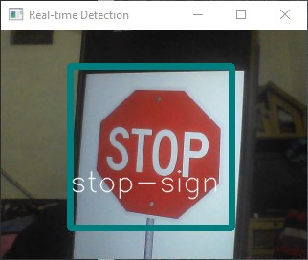
RESULTS
Here, in this project we’ve considered around 10 objects to be
detected in Real-Time. Some of those include ‘Stop Sign’, ‘Football’,
‘Number Plate’, ‘Banana’, ‘car’, ‘Traffic light’ etc.
Input Output

Slide 11
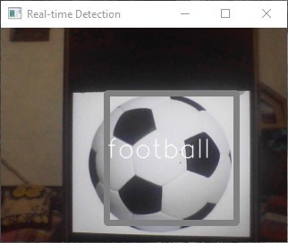
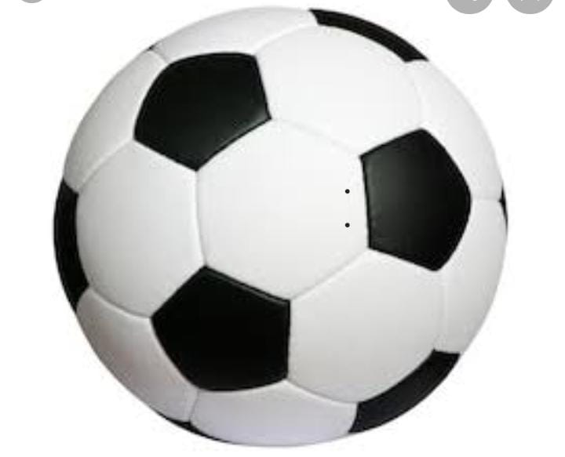
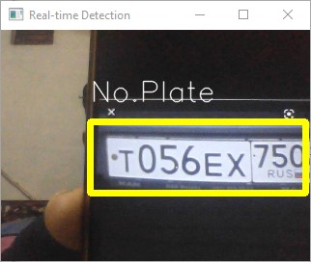
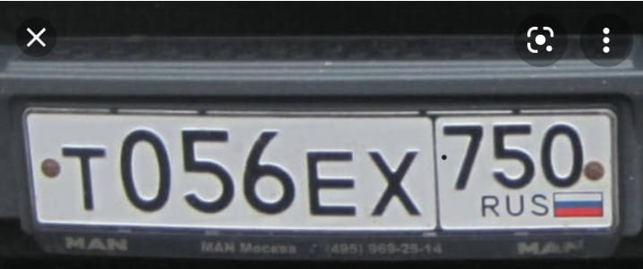

Slide 12
Future Scope
FACIAL RECOGNITION - “Deep Face” is a deep learning facial recognition system developed to identify human faces in a digital image. Designed and developed by a group of researchers in Facebook. Google also has its own facial recognition system in Google Photos, which automatically separates all the photos according to the person in the image.
PEOPLE COUNTING - People counting is also a part of object detection which can be used for various purposes like finding person or a criminal
SELF DRIVING CARS - Self-driving is the future most promising technology to be used, but the working behind can be very complex as it combines a variety of techniques to perceive their surroundings, including radar, laser light, GPS, odometer, and computer vision. Advanced control systems interpret sensory info to allow navigation methods to work, as well as obstacles and it. This is a big step towards Driverless cars as it happens at very fast speed.

Slide 13
Difficulties And Problems In Object Detection
Illumination The lightning conditions may differ during the course of the day. Also the weather conditions may affect the lighting in an image
Positioning The change in position must not affect the recognition system.
Rotation The image can be in rotated form. The system must be capable to handle such difficulty
Mirroring The mirrored image of any object must be recognized by the object recognition system.
Occlusion The condition when object in an image is not completely visible is referred as occlusion.
Scale Changes in the size must not affect the Occluded car recognition system

Slide 14
Conclusion
In this presentation, we have overviewed the following points
Basic concept of Object Detection
Representation of objects
Techniques in object recognition
Multiple and single object detection and machine learning process
Object detection is a task of extracting Objects from specific frames/images
Object detection is one of the most widely used concept in the field of Artificial Intelligence
Has a great scope in future for the development of the modern world.

Slide 15
References
Machine learning Workshop conducted by TechieNest Pvt.Ltd. In association with Aavriti 19 IIT BOMBAY.
https://www.geeksforgeeks.org/python-haar-cascades-for-object-detection/?ref=lbp
https://github.com/opencv/opencv/tree/master/data/haarcascades

Slide 16
THANK YOU!!

